Slide 1
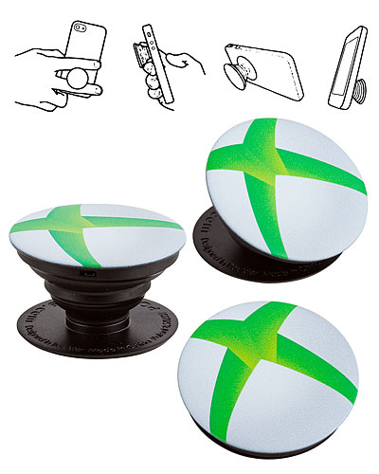





Small Items

Slide 2








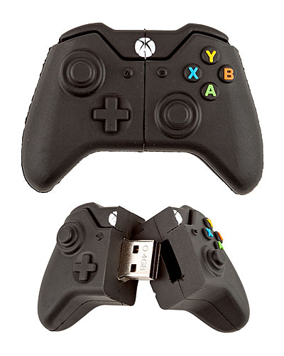
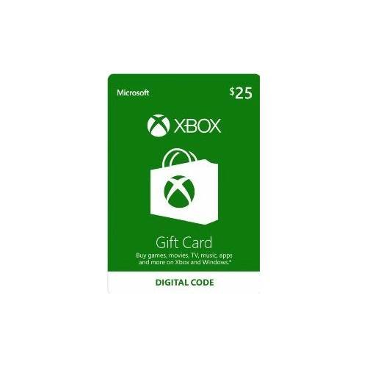



Medium Items
PLUS ALL SMALL
ITEMS

Slide 3





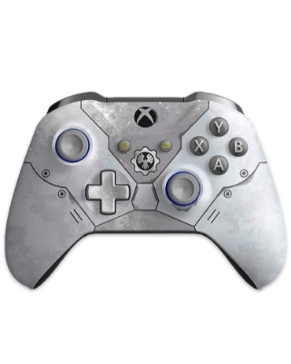






Large Items
PLUS ALL SMALL & MEDIUM ITEMS

